Slide 1
CHITTENANGO CENTRAL SCHOOLS
The Pursuit of Excellence is a Journey Without End

Slide 2
Commitment to Excellence
We Are Chittenango…
We believe safe, secure and well-maintained facilities are essential. Our children deserve a premier learning environment – atmosphere/program/brick & mortar.
We believe a culture of kindness that nurtures; strong character development, citizenship, integrity, empathy and perseverance is critical for student success.
We believe in teaching our children to strive for academic/athletic/extra-curricular excellence; to expect the best for themselves and be willing to work for it.
We believe in Community ~ Family ~ Chittenango; thus, the success of our schools is among the most valuable asset to owning a home in this community.
We believe in fiscal solvency, fiduciary duty and long range planning predicated upon our solemn responsibility to the taxpayers.

Slide 3
A Commitment To Excellence: Budget & Planning - Vision & Belief Statements
The proposed budget should provide financial viability for the implementation of our Long-Range Plan which strives to:
Maintain quality academic and extra-curricular programs, with well-planned calculated expansion/contraction;
Maintain all staffing necessary to provide a world-class educational program, with strategic re-deployment of personnel over time relative to declining enrollment; and
Maintain all facilities, infrastructure, technology, resources and supplies, with tactical acquisition of updated “tools” in concert with district strategic planning.
Uphold our commitment to building for our future while being fiscally responsible to the Chittenango Schools’ community and taxpayers.

Slide 4
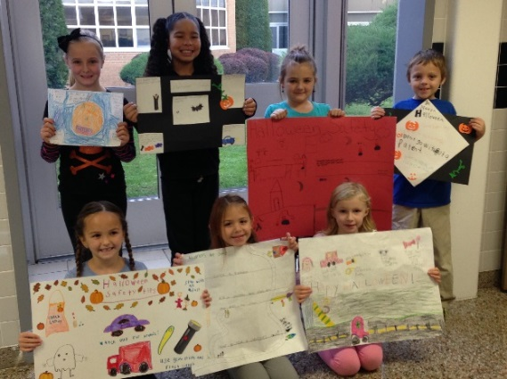
2019-2020Budget Forecast
Proposed Spending Plan $40,023,362
Tax Levy Revenue* ($18,202,737)
State Aid ($19,721,592
Other Revenue ($ 590,200)
GAP $ 1,508,833
*Reflects Tax Levy Inc. of 2.0%. Our tax levy limitation
would allow an increase of 2.58%.

Slide 5
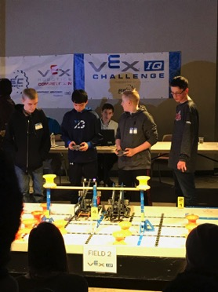
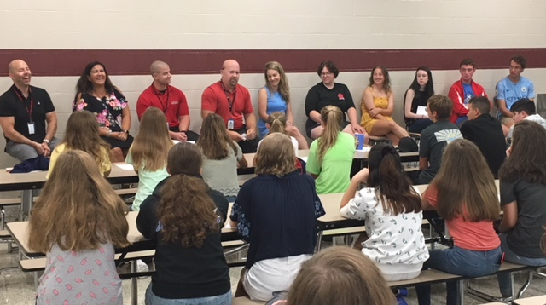
Budget Comparison
2019-20 Budget $ 40,023,362
2018-19 Budget $ 39,272,229
Budget-to-Budget Increase $ 751,134

Slide 6
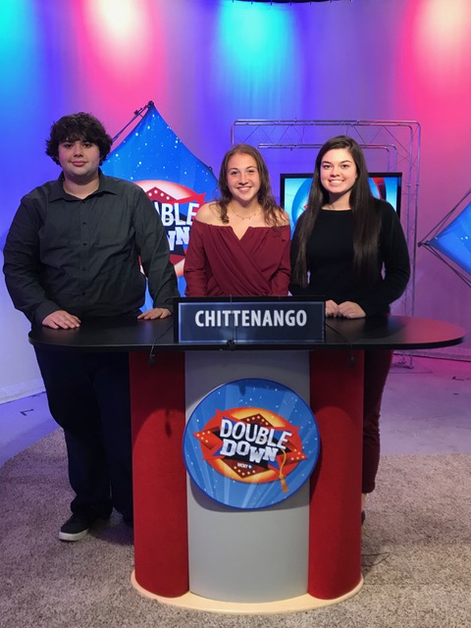
Budget-to-Budget Comparison:
2011-12 Budget $ 36,193,920
2012-13 Budget $ 35,957,544
2013-14 Budget $ 36,499,073
2014-15 Budget $ 37,417,871
2015-16 Budget $ 36,958,984
2016-17 Budget $ 37,468,962
2017-18 Budget $ 37,891,782
2018-19 Budget $ 39,272,229
2019-20 Budget $ 40,023,362
Difference $ 751,134
Budget-to-Budget Increase = 1.91%

Slide 7
Budget Increase Drivers
Amount Percent
Instructional Salaries $ 510,534 3.95%
Non-Instructional Salaries 127,256 2.30%
BOCES 616,839 23.54%
Tuition (84,450) -45.11%
Employee Benefits 436,449 3.80%
TRS/ERS Retirement (177,326)
Health & Dental 547,136
Social Security & Other 66,639
Debt Service (899,432) (25.83%)
Other* 43,938 1.85%
TOTAL $751,134 1.91%
Includes a Transfer to the Capital Fund of $100,000 for boiler
replacement (mini-capital project) – will receive 84.9% aid

Slide 8
Budget Summary - Expenses
Category | 2018-2019 | 2019-2020
Administrative Component | $ 2,991,858 | $ 3,116,321
Program Component | $28,954,217 | $30,419,415
Capital Component (Includes $100,000 Transfer to Capital Fund) | $ 7,326,154 | $ 6,487,628
Grand Total | $39,272,229 | $40,023,362
Budget-to-Budget Increase/(Decrease) |  | $751,134

Slide 9
Budget Summary - Revenues
Category | 2018-2019 | 2019-2020
Foundation Aid | $13,200,263 | $13,353,209
BOCES Aid | 1,369,245 | 1,411,000
Building Aid | 3,066,529 | 1,926,457
Expenditure Driven | 2,736,851 | 3,030,926
Other | 451,950 | 590,200
Appropriated Fund Balance | 601,570 | 1,508,833
Tax Levy | 17,845,821 | 18,202,737
Total | $39,272,229 | $40,023,362

Slide 10
Tax Levy Comparison
Year Levy Increase
2012-2013 $16,720,652 2.0%
2013-2014 $17,055,065 2.0%
2014-2015 $17,455,859 2.35%
2015-2016 $17,708,969 1.45%
2016-2017 $17,538,890 (0.96%)
2017-2018 $17,538,890 0%
2018-2019 $17,845,821 1.80%
2019-2020 $18,202,737 2.0%
Our tax levy limitation would allow for an increase of 2.58%

Slide 11
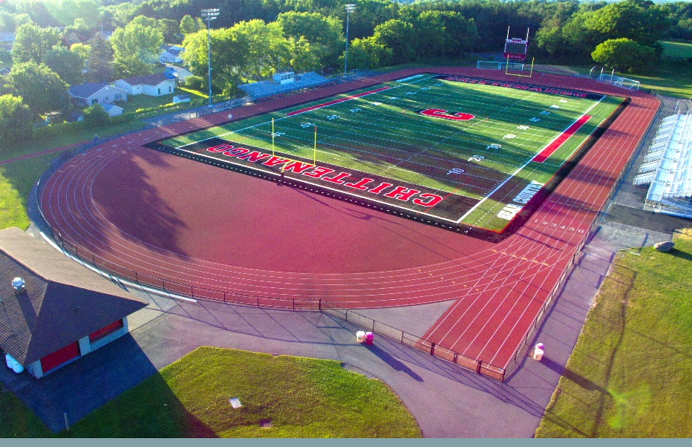
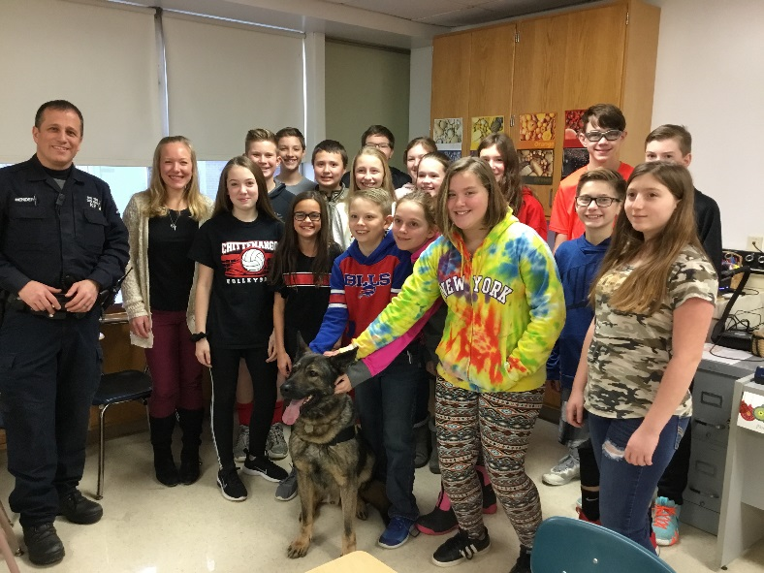
Budget Enhancements/Impacts
Addition of one section TPK (targeted pre-k)
6 Additional Coaching Positions and 1 Advisor
1.0 FTE Social Worker – Middle School
1.0 Teaching Assistant - Bridgeport
Enhanced funding for Science Olympiad and Robotics
Enhanced Safety and Security Measures

Slide 12
SROs in all Four (4) Buildings
2019 Best Communities for Music Education + Representation at All-County Events
Proud Accomplishments
Scholastic Art Awards (Two (2) National Silver Medalists)
84% of Class of 2018 went on to higher education (50% Four year, 34% Two year)
57% of members of Class of 2018 earned an Advanced Regents Diploma
15 Advanced Placement (AP) Scholars (scores of 3+ on all AP exams taken)
2 National Merit Commended Students based on performance on the PSAT
14 Students selected to the National Technical Honor Society and OCM/MO BOCES
All of our Fall and Winter teams have qualified for sectional playoffs. The majority of teams achieved Scholar Athlete status.
ROBO Bears Success (CMS/CHS Robotics Teams)
Science Olympiad at MIT

Slide 13
Continuous Cost Savings
Energy Management Software – all facilities.
Participation in OCM BOCES Cooperative for Purchasing, Safety, Health and Workers’ Compensation consortiums.
Analyze all vacancies for restructuring/replacement costs.
Currently host fueling for five (5) branches of local government – continue to hold discussions to add additional sources.
Maximize sale of surplus goods via Auction’s International.
Consolidated bus vote with budget vote – savings of approximately $5,800
Continue to explore sale/lease of Lake Street Elementary

Slide 14
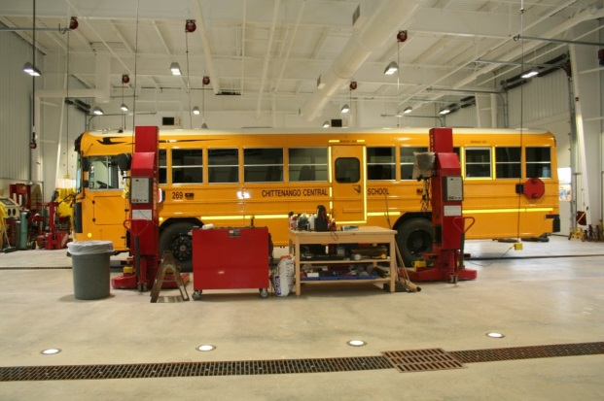
RATIONALE Bus Proposition
A Citizens’ Committee recommended that buses be replaced after 10 years of service to maximize bus safety and to reduce repair expenses.

Slide 15
BUSES TO BE REPLACED:
5 - 66 Passenger Buses
1 – Wheel chair bus
Bus: Mileage: Year:
Bus 226 - 183,307 2007
Bus 229 - 165,131 2007
Bus 240 - 94,732 2009
Bus 241 - 91,371 2010
Bus 242 - 99,626 2010
Bus 243 - 69,466 2010

Slide 16
RECOMMENDED BUSES TO BE PURCHASED:
Five (5) 71 Passenger Vision Gas powered - $112,781 X 5 = $563,902
One (1) wheel chair bus Vision Gas powered - $134,017
2018-2019 2019-2020
*Total Cost = $560,000 $697,919
**Cost per year = $ 26,230 $ 29,033
* Excludes the value of auctioning off retired buses
**After factoring in State Aid at 79.2%
Buses are purchased via a five (5) year B.A.N. to tie into the state aid model that aids the district over 5 years for bus purchases. We should average $5,000 per bus via the auction process, thus we would pay down the borrowing by $30,000 upon the sale of buses, lowering the annual cost from $29,033 to $23,033.

Slide 17
Budget Propositions:
Proposed School Budget: $40,023,362
Proposed School Bus Purchase: $697,919
Proposed Capital Reserve renewal:$6.0 million
Board of Education Elections: Three (3) Seats
Funding for Sullivan Free Library: $559,788

Slide 18
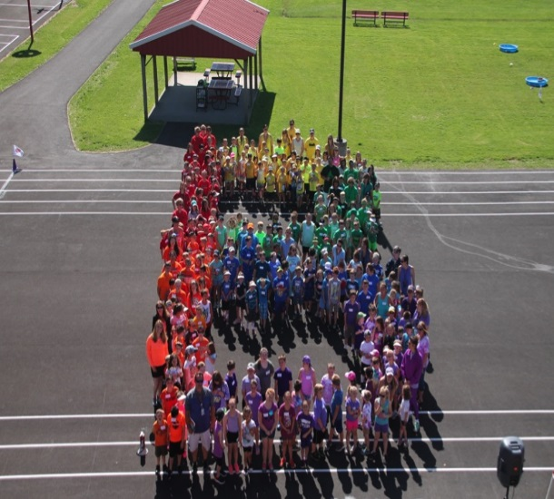
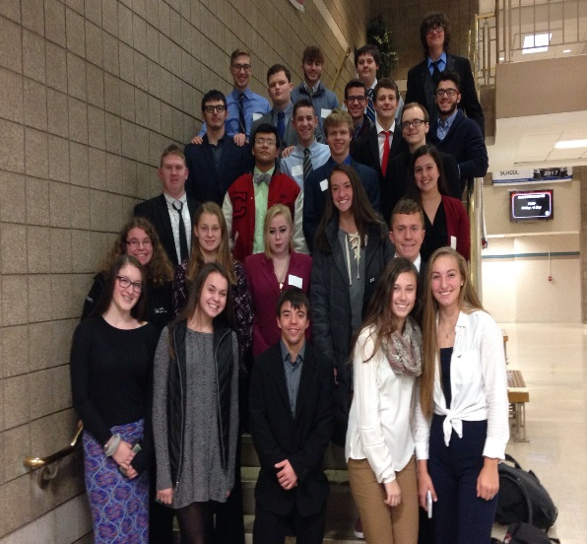
Chittenango Central Schools
Annual Budget Vote
Tuesday, May 21, 2019
12:00 – 9:00 p.m.
Please visit our website, www.chittenangoschools.org,
for updated information regarding the above. We
encourage you to vote on May 21st.

Slide 19
A Commitment to Excellence: 2019-2020 budget presentation: BEAR PRIDE!
QUESTIONS?

