Slide 1
Chittenango Central School District Smart Schools Investment Plant (SSIP)

Slide 2
What is the Smart Schools Bond Act?
The Smart Schools Bond Act (SSBA) was passed by the New York State Legislature in the 2014-15 enacted budget and was approved by the voters via a statewide referendum during the 2014 General Election held on November 4, 2014. The results of this positive vote allowed the authorization to issue $2 billion of general obligation bonds to finance school district improvements in the areas of education technology, infrastructure and security. For a complete description of the Smart Schools Bond Act, the implementation guide can be located at: http://www.p12.nysed.gov/mgtserv/smart_schools/docs/Smart_Schools_Bond_Act_Guidance_04.27.15_Final.pdf.

Slide 3
District Allocation
The Chittenango Central School District was awarded an allocation in the amount of $1,653,971.00. The funds must be spent using school district dollars then seek reimbursement from New York State after the funds have been spent. Under the current guidance, there has been no time limit placed on purchases to be reimbursed as well as no requirement to spend all of the funds at one time.

Slide 4
District Overview of the SSIP
School Connectivity
We currently have about 75% wireless coverage blending newer access points with second generation access points that will need to be replaced.
The plan calls for upgrading older access points and to achieve 100% wireless coverage for all instructional areas by March 2017.
The plan calls fro upgrading/replacing
all network switches with POE switches.

Slide 5
Instructional Technology to Enhance Learning and Teaching
The district has begun the process of deploying 1:1 mobile devices for grades K, 4, 6 and 7 as well as creating mobile device “pods” in grades 1, 2, 3 and 8.
As part of our enhanced learning process, our ultimate goal will be to provide 1:1 mobile devices for grades 2-12 and a 2:1 mobile device allocation for grades K-1.
To accomplish this, the process will be to provide iPad devices in grades K-8 with the implementation of chrome book carts for diversity and versatility and then provide chrome books in a 1:1 environment for grades 9-12 while having iPad carts available in the high school learning environment.

Slide 6
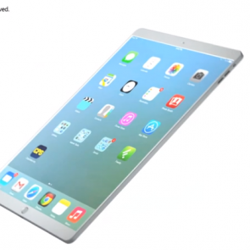
We currently have 296 iPads that are greater than 4 years of age, 300 desktop computers in excess of 5 years of age and approximately 74 laptops in excess of 4 years of age. Our plan calls for the replacement of all devices in excess of 5 years of age over a three (3) year period.
The backbone or storage devices for our data and student accounts will need to be upgraded with a RAID 5E SAN (Storage Area Network) configuration.

Slide 7
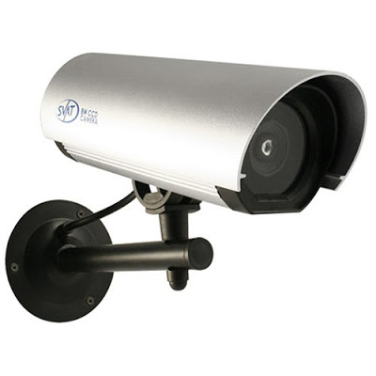
High Tech Security
As part of that process, the district had the foresight to build an infrastructure to support additional cameras within the district’s instructional buildings.
The safety of our students and staff are a top priority of the Board of Education and we plan to install additional security cameras throughout the district to have complete coverage of both internal and external areas of our campuses.

Slide 8
Preliminary Smart School Investment Plan Expenditures
Wireless Access Point…………………………. $ 165,514
POE Network Switches………………………… 291,644
Laptop Replacements………………………….. 50,000
Desktop Replacements……………..………….. 225,000
iPads/Chrome books…………………………… 185,000
Servers/Storage Devices………………………. 55,706
Security Cameras………………………………. 25,000
Initial Phase Expenditures $ 998,864
Future Phases for Replacement Cycles $ 655,107

Slide 9
Versatility& Diversity

Slide 10
District Timeline
March 2, 2016 Review of plan with district administrative team.
March 5, 2016 Preliminary Smart Schools Investment Plan posted on district website for public comment.
March 15, 2016 Preliminary Smart Schools Investment Plan approved by the Board of Education.
April 12, 2016 Public hearing at the Board of Education meeting to present/discuss the Preliminary Smart Schools Investment Plan. Final SSIP approved by the Board of Education.
April 15, 2016 Smart School Investment Plan submitted to the State Education Department for approval.

