Slide 1
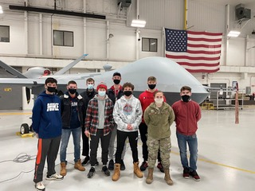

CHITTENANGO CENTRAL SCHOOLS Going Above and Beyond
The Pursuit of Excellence –
A Journey Without End

Slide 2

Commitment to Excellence
We Are Chittenango…
We believe safe, secure and well-maintained facilities are essential. Our children deserve
a premier learning environment – atmosphere/program/brick & mortar.
We believe a culture of kindness that nurtures; strong character development, citizenship,
integrity, empathy and perseverance is critical for student success.
We believe in teaching our children to strive for academic/athletic/extra-curricular
excellence; to expect the best for themselves and be willing to work for it.
We believe in Community ~ Family ~ Chittenango; thus, the success of our schools is
among the most valuable asset to owning a home in this community.
We believe in fiscal solvency, fiduciary duty and long-range planning predicated upon
our solemn responsibility to the taxpayers.

Slide 3

A Commitment To Excellence:
Budget & Planning - Vision & Belief Statements
The proposed budget should provide financial viability for the implementation of our Long-Range Plan which strives to:
Maintain quality academic and extra-curricular programs with well-planned calculated expansion/contraction;
Maintain all staffing necessary to provide a world-class educational program, with strategic re-deployment of personnel over time relative to declining enrollment; and
Maintain all facilities, infrastructure, technology, resources and supplies, with tactical acquisition of updated “tools” in concert with district strategic planning.
Uphold our commitment to building for our future while being fiscally responsible to the Chittenango Schools community and taxpayers.

Slide 4
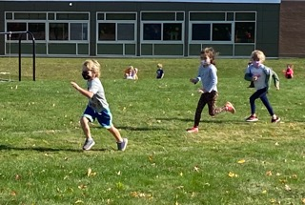
2021-2022 Budget Forecast
Proposed Spending Plan $42,012,343
Tax Levy Revenue* ($18,882,450)
State Aid ($20,983,527)
Other Revenue ($ 904,600)
GAP $ 1,241,766
*Reflects Tax Levy Inc. of 1.95%. Our tax levy limitation
would allow an increase of 2.69%.

Slide 5
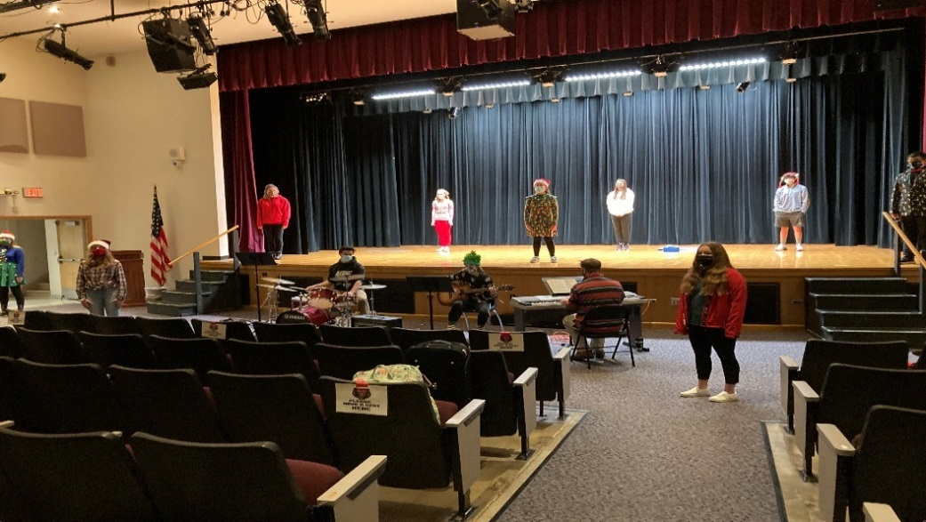
Budget Comparison
2021-22 Budget $ 42,012,343
2020-21 Budget $ 41,293,599
Budget-to-Budget Increase $ 718,784

Slide 6
Budget-to-Budget Comparison:
2013-14 Budget $ 36,499,073
2014-15 Budget $ 37,417,871
2015-16 Budget $ 36,958,984
2016-17 Budget $ 37,468,962
2017-18 Budget $ 37,891,782
2018-19 Budget $ 39,272,229
2019-20 Budget $ 40,023,362
2020-21 Budget $ 41,293,559
2021-22 Budget $ 42,012,343
        Difference $ 718,784
Budget-to-Budget Increase = 1.74%

Slide 7
Budget Increase Drivers
Amount Percent
Instructional Salaries $253,803 1.86%
Non-Instructional Salaries $308,917 5.46%
BOCES $49,683 1.48%
Employee Benefits $435,252 3.59%
  TRS/ERS Retirement $144,834
  Health & Dental $238,980
  Social Security & Other $51,438
Debt Service ($386,925) -11.41%
Other* $58,054 .01%
TOTAL $718,784 1.74%
Includes a Transfer to the Capital Fund of $100,000 for security upgrades/enhancements at the MS (mini-capital project) – will receive 84.9% aid

Slide 8
Budget Summary - Expenses
Category | 2020-2021 | 2021-2022
Administrative Component | $3,083,172 | $3,204,458
Program Component | $30,880,386 | $31,813,831
Capital Component (Includes $100,000 Transfer to Capital Fund) | $7,330,001 | $6,994,054
Grand Total | $41,293,559 | $42,012,343
Budget-to-Budget Increase/(Decrease) |  | $718,784

Slide 9
Budget Summary - Revenues
Category | 2020-2021 | 2021-2022
Foundation Aid | $13,360,062 | $13,713,275
High Cost/Private Cost | $509,562 | $555,185
HW/SW/Textbook | $189,019 | $182,437
Transportation | $2,414,048 | $2,554,251
Building | $2,495,014 | $2,237,867
BOCES | $1,409,649 | $1,740,512
Other (Includes $285K Pandemic Grant) | $1,132,569 | $904,600
Appropriated Fund Balance | $1,262,351 | $1,241,766
Tax Levy | $18,521,285 | $18,882,450
Total | $41,293,559 | $42,012,343

Slide 10
Tax Levy Comparison
Year Levy Increase
2014-2015 $17,455,859 2.35%
2015-2016 $17,708,969 1.45%
2016-2017 $17,538,890 (0.96%)
2017-2018 $17,538,890 0%
2018-2019 $17,845,821 1.80%
2019-2020 $18,202,737 2.0%
2020-2021 $18,521,285 1.75%
2021-2022 $18,882,450 1.95%
Our tax levy limitation would allow for an increase of 2.69%

Slide 11
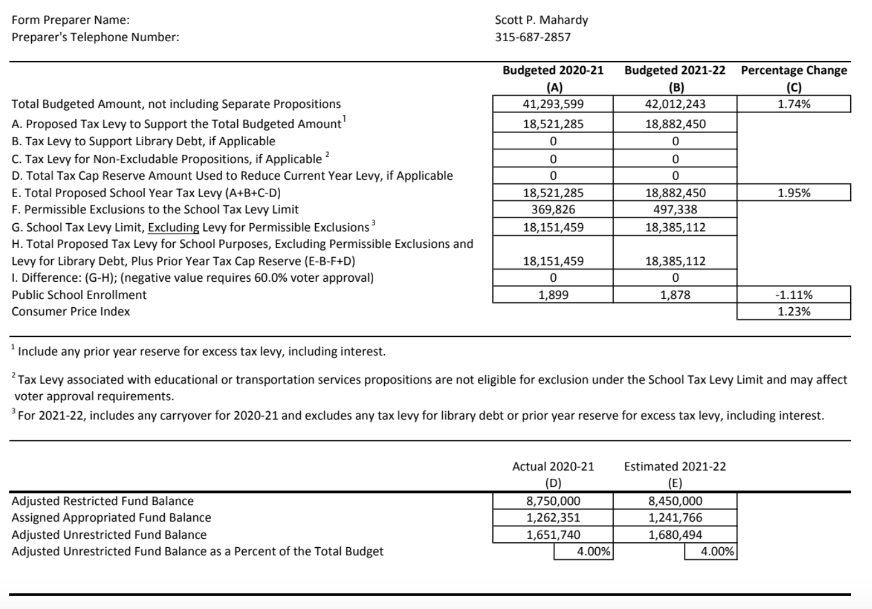

Slide 12
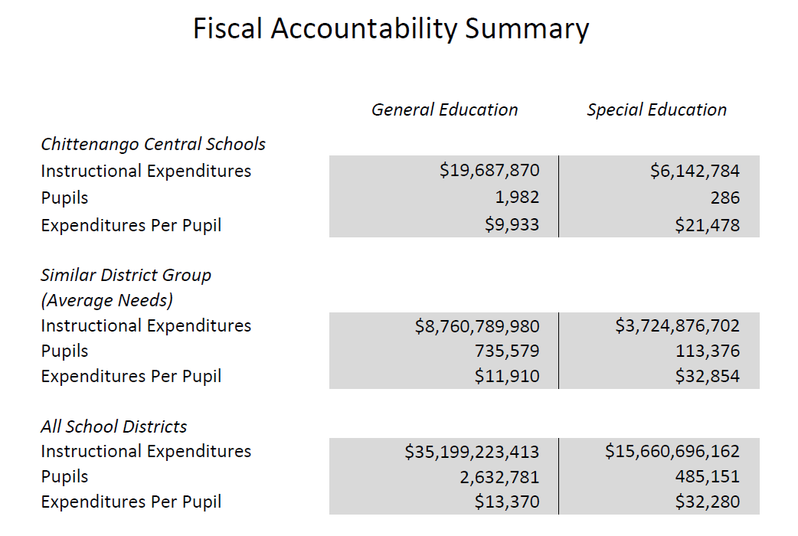

Slide 13
Continuous Cost Savings
Energy Management Software – All Facilities
Participation in OCM BOCES Cooperative for Purchasing, Safety, Health and Workers’ Compensation consortiums
Analyze all vacancies for restructuring/replacement costs
Currently host fueling for five (5) branches of local government – continue to hold discussions to add additional sources
Maximize sale of surplus goods via Auctions International
Consolidated bus vote with budget vote – savings of approximately $5,800
Lease of Lake Street Elementary

Slide 14
Program Enhancements
    Mental Health Support
    Occupational Therapist Assistant
    Special Education Continuum Teacher
    Increased Summer Learning Funding
    Administrative Intern – Bolivar (BOCES Reimbursed)
    Writing Consultant Funding

Slide 15
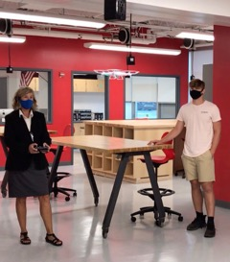
Chittenango CSD 2020-2021 Highlights
Bridgeport Elementary State School of Character
Community Connections / Bear Care Program
Regents / AP Programs
Technology Upgrades
Music and Art Awards
Athletics / Extra-Curricular Activities
Going Above and Beyond

Slide 16
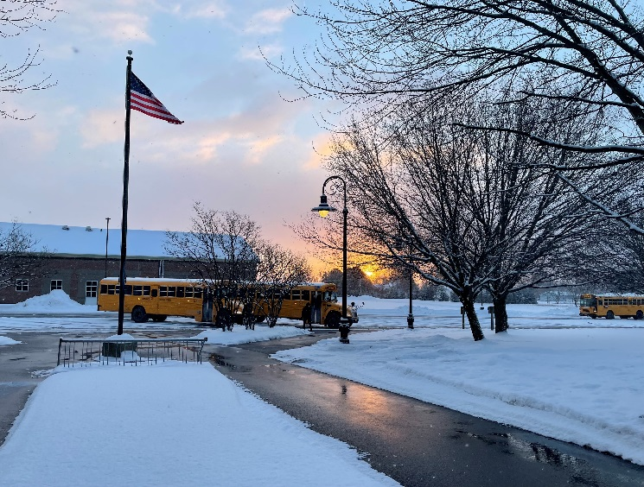
RATIONALE Bus Proposition
The Facilities/Transportation Committee recommends that buses be replaced after 10 years of service to maximize bus safety and to reduce repair expenses.

Slide 17
BUSES TO BE RETIRED:
4 - 71 Passenger Buses
Bus: Mileage: Year:
  Bus 249 - 110,366 2011
  Bus 257 - 77,439 2013
  Bus 258 - 85,419 2013
  Bus 259 - 103,894 2013

Slide 18
RECOMMENDED BUSES TO BE PURCHASED:
Three (3) 71 Passenger Vision Gas Powered - $124,294 X 3 = $372,882
2020-21 2021-2022
*Total Cost = $753,205 $372,882
**Cost per year = $ 31,333 $ 15,512
* Excludes the value of auctioning off retired buses
**After factoring in State Aid at 79.2%
Buses are purchased via a five (5) year B.A.N. to tie into the state aid model that aids the District over 5 years for bus purchases. We should average $5,000 per bus via the auction process, thus we would pay down the borrowing by $15,000 upon the sale of buses, lowering the annual cost from $15,512 to $10,512.

Slide 19

Budget Propositions:
Proposed School Budget: $42,012,343
Proposed School Bus Purchase: $372,882
Board of Education Elections: Three (3) Seats
Funding for Sullivan Free Library: $585,259

Slide 20
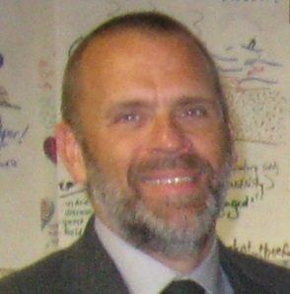
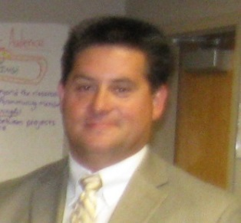
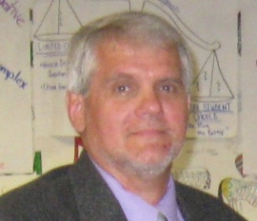
Board of Education Seats:
(Vote for one person for each seat)
Seats for three-year terms now held by:
James Boswell
Daniel Mayer
Russell Wehner
Candidate(s):
James Boswell
Daniel Mayer
Russell Wehner

Slide 21
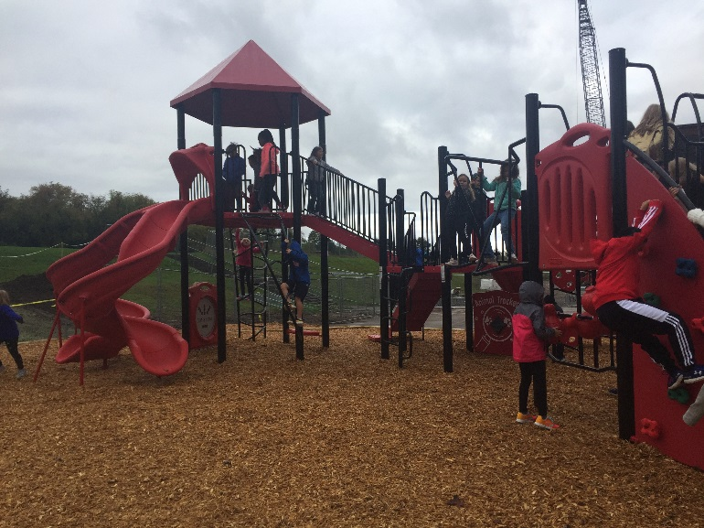

Chittenango Central Schools
Annual Budget Vote
Tuesday, May 18, 2021
Please visit our website, www.chittenangoschools.org,
for updated information regarding the above. We
encourage you to vote on May 18th.

Slide 22

F U T U R E ?

Slide 23

A Commitment to Excellence:
2021-2022 Budget Presentation: BEAR PRIDE!
QUESTIONS?

